Slide 1
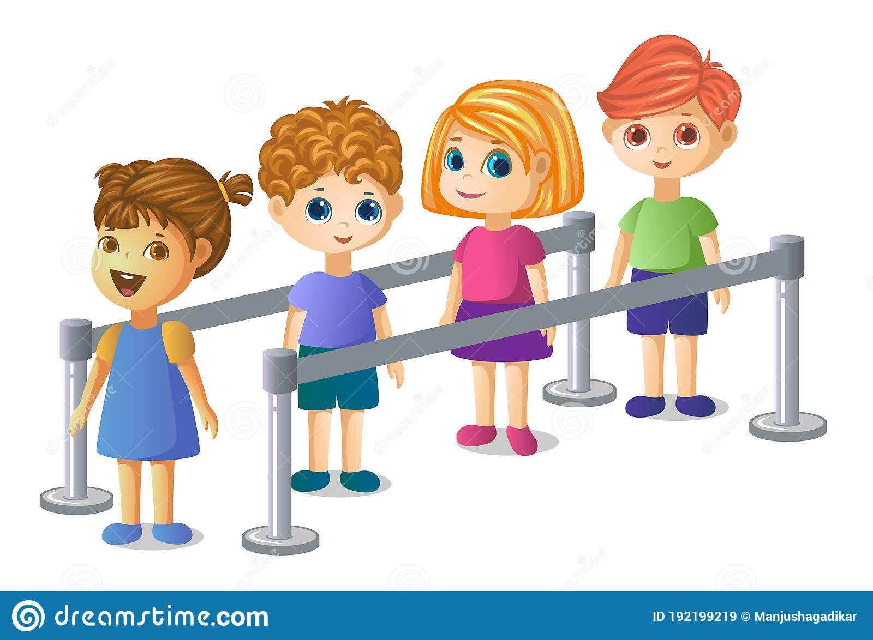
QUEUE

Slide 2
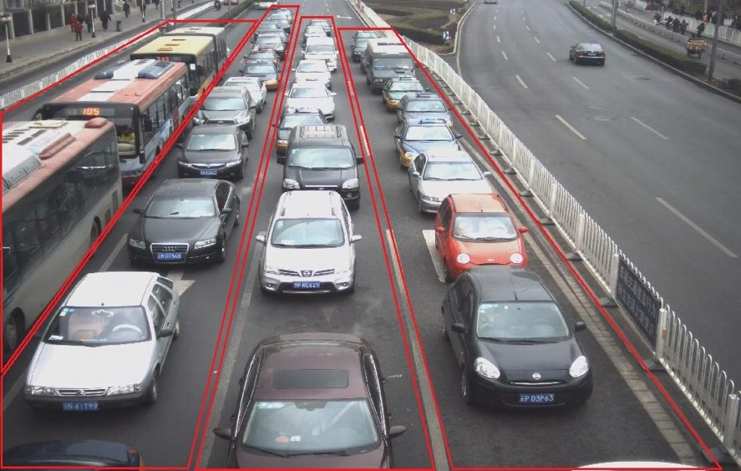

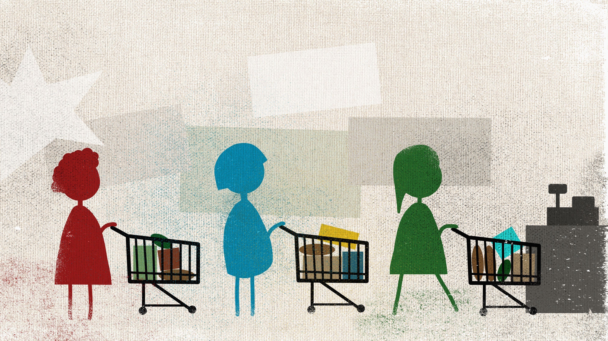
QUEUE
Queue is a line or sequence of people or vehicles awaiting their turn to be attended to or to proceed is called Queue.
Queue is a line of people or things or objects awaiting their turn to be attended is called Queue.

Slide 3
QUEUE
It Is a linear structure of items (like mechanical parts assembling) and waiting for their turn.
Queue is line of items waiting for their turn.
Queue has two ends:
Elements are added at one end (REAR END).
Elements are removed from the other end (FRONT END).
EXAMPLES OF QUEUE: People waiting in Queue to purchase tickets at railway station or cinema hall, where the first person in the queue will be served first.

Slide 4
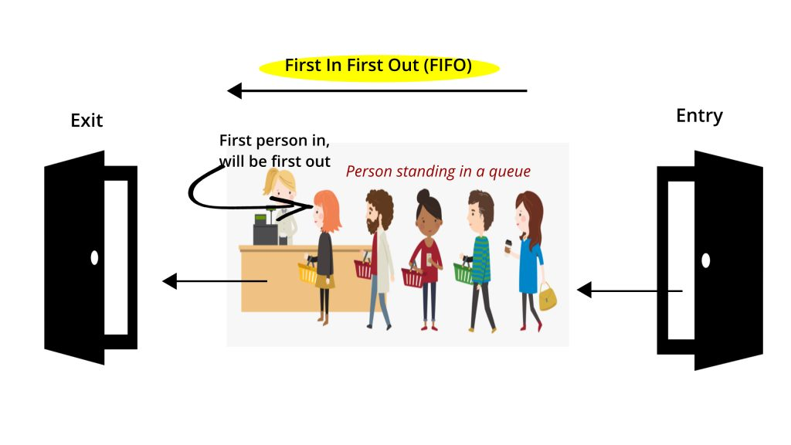
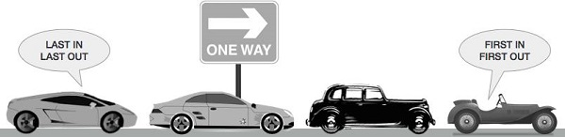
GENERAL WORKING PRINCIPLE OF QUEUE (FIFO)
It works on the principle of FIFO (First In First Out). That is, the element that is added first, it is removed first, and the element that is added to the last, it is removed at the end.

Slide 5
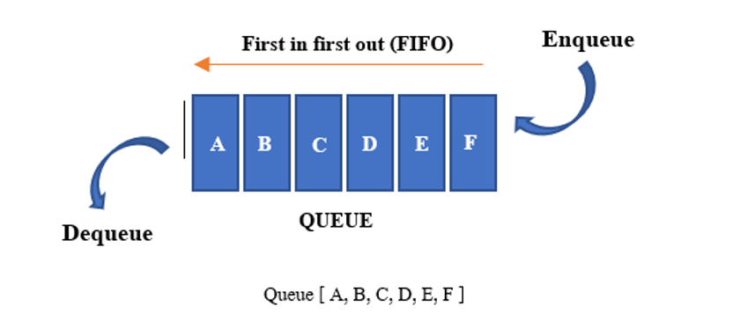
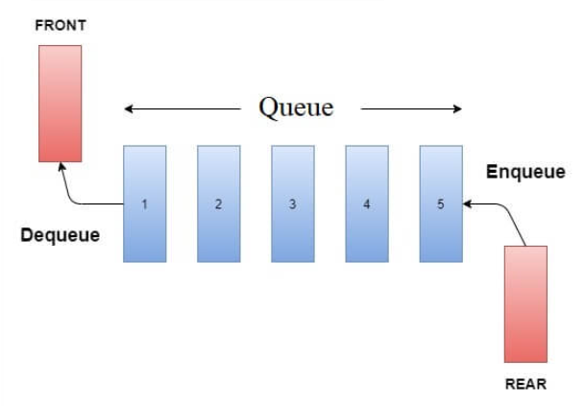
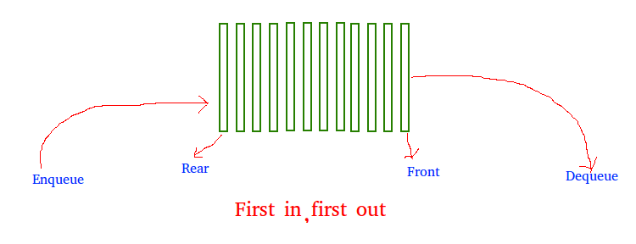
GENERAL WORKING PRINCIPLE OF QUEUE (FIFO)

Slide 6
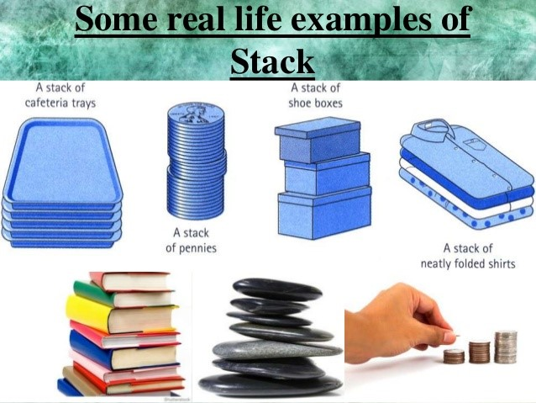
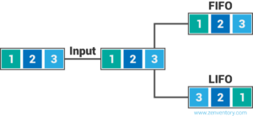
LIFO (STACK)
A collection of items are added and removed from one end, called the top of the Stack.
"LIFO" stands for last-in, first-out, meaning that the most recently produced items are recorded as sold first.
Example: A Stack of Plates

Slide 7
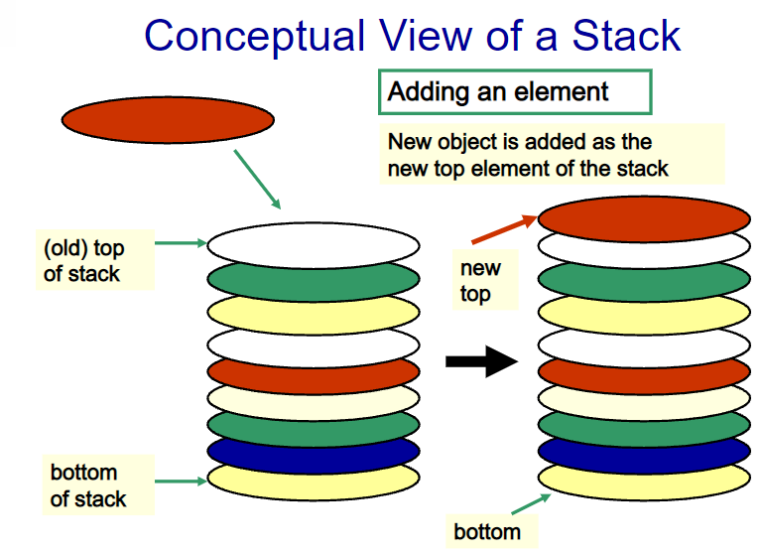
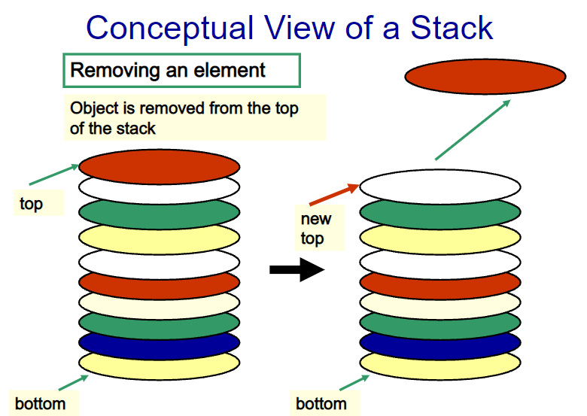
LIFO (STACK)(Loading a Truck)

Slide 8
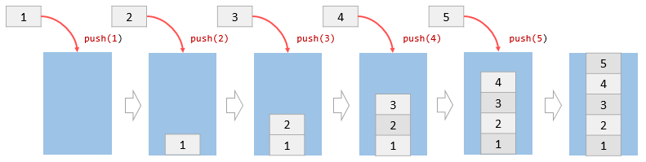
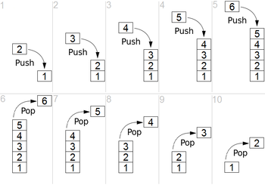
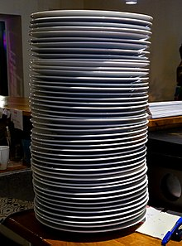
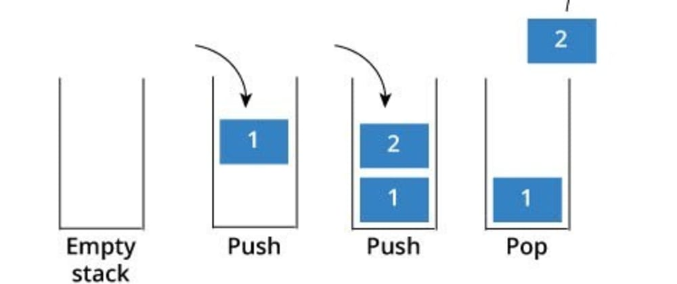
OPERATIONS ON A LIFO (STACK)
Push: Adds an items to the top of the Stack is called Push.
Pop: Removes an element from the top of the Stack is called as Pop.
Size: Determines the number of elements is called as Size.
IsEmpty: Determines whether the Stack is Empty

Slide 9
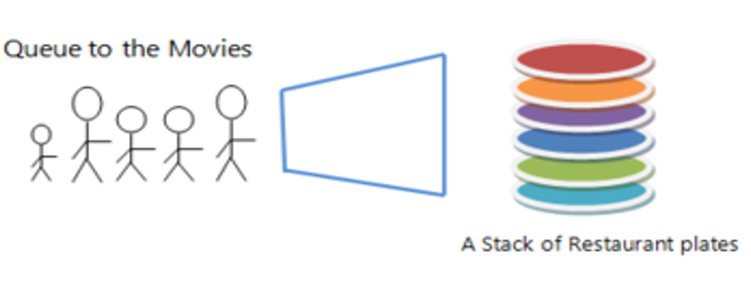
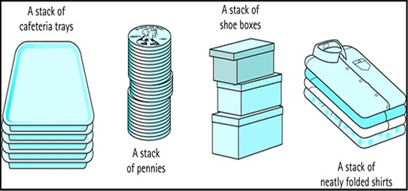
Examples of Queue and Stacks

Slide 10
SIRO (Serve in Random Order) OR ROS (Random-Order-Of-Service)
The random-order-of-service (ROS) policy, or alternatively, service-in-random-order (SIRO), is a well-known and important alternative to the first-come-first-served (FCFS) policy and the related first-in-first-out (FIFO) policy.

Slide 11
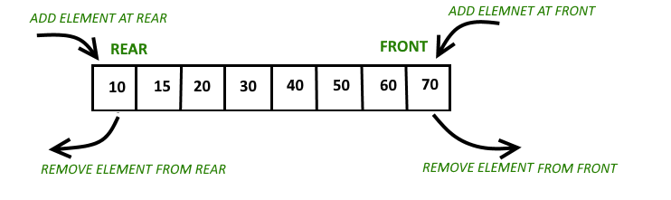
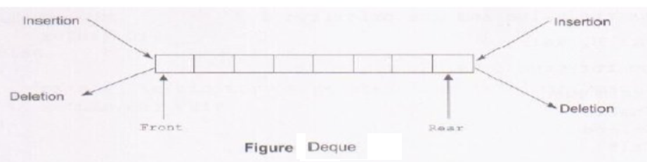
DEQUE
Deque is the short form of Double-Ended Queue.
In DEQUE linear list of elements can be insert/add or deleted at either end but not in the middle.

Slide 12
TYPES OF QUEUE
Circular Queue
Priority Queue (M-Tag)
Input Restricted Queue (An input restricted queue is a special case of double ended queue where data can be inserted from one end but can be removed from both ends).
Output Restricted Queue (In this type of Queue, the input can be taken from both sides and the deletion of the element can be done from only one side).

Slide 13
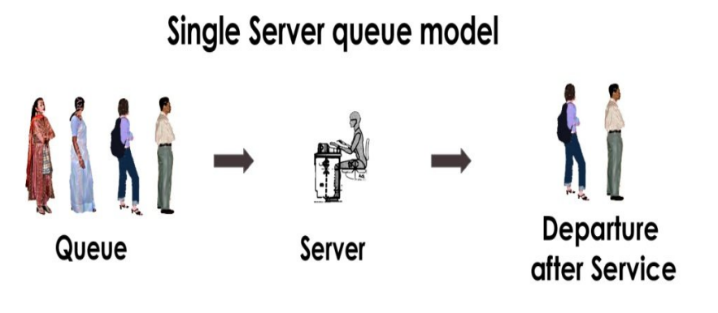
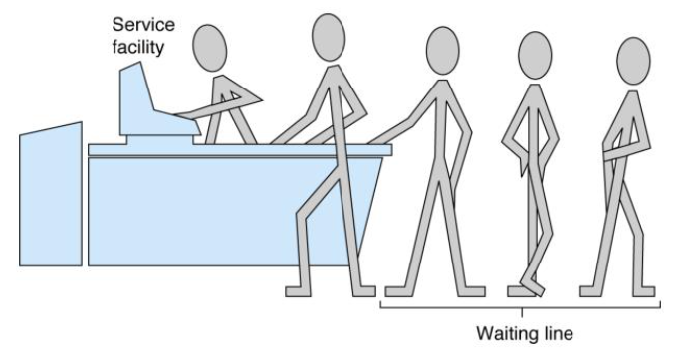
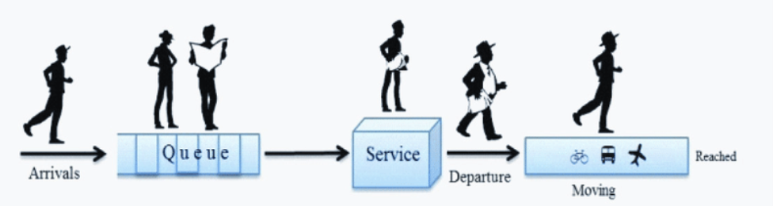
Single Server Queue Model

Slide 14
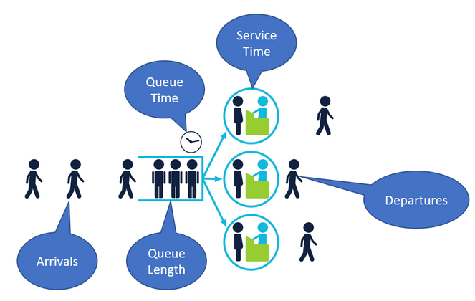
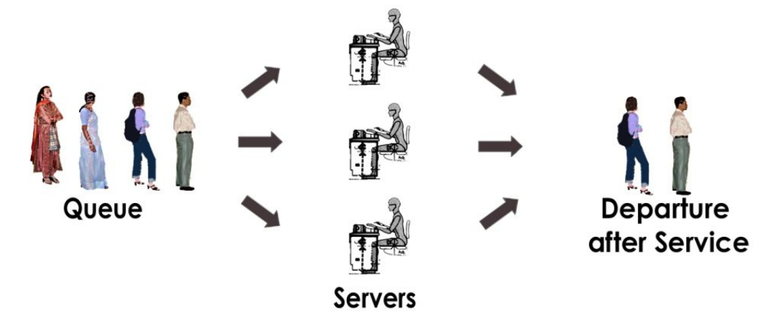
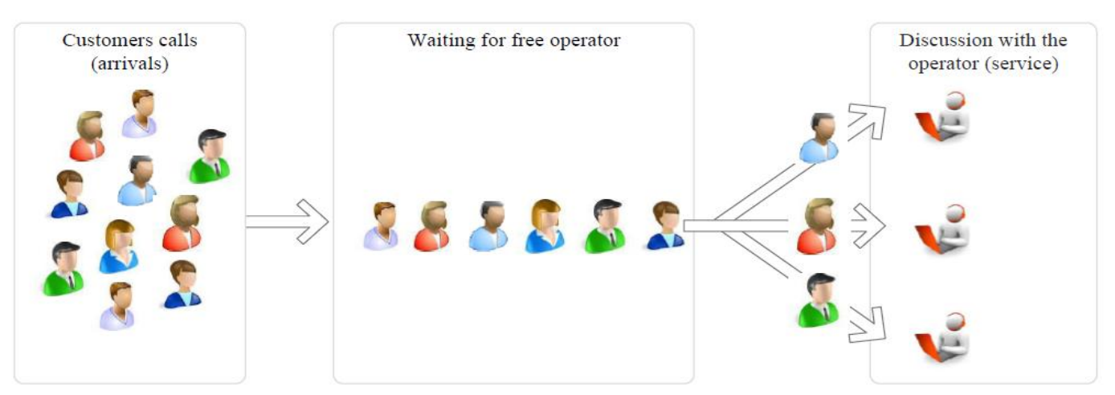
Multi-Server Queue Model

Slide 15
Applications of Queue
There are numerous applications of queue in daily life are as under:
Railway ticket reservation system.
Banking system.
Traffic Control
Air ticket Sales.
Medical Health Service.

